Slide 1
CSE 471: MACHINE LEARNING
Transformer Variants

Slide 2


Vision Transformer (ViT)
Extract patches (p×p) from image (h×w)
  Number of patches, m = hw/p²
  Flattened to vector of length cp²
    c → Number of channels in the input image
Feed the vectors representing the patches into a Transformer encoder
A special <cls> token is also added.

Slide 3
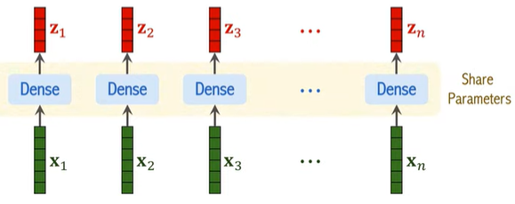
Vision Transformer (ViT)
Patch size: 16×16 used in the ViT paper
Stride: 16×16 [Non-overlapping patches]
Smaller stride w.r.t patch size will result in more (overlapping) patches.
A dense layer is applied without non-linear activation
  z_{i} = Wx_{i} + b [All patches use the same weights]
Image from: https://www.youtube.com/watch?v=HZ4j_U3FC94&t=440s

Slide 4
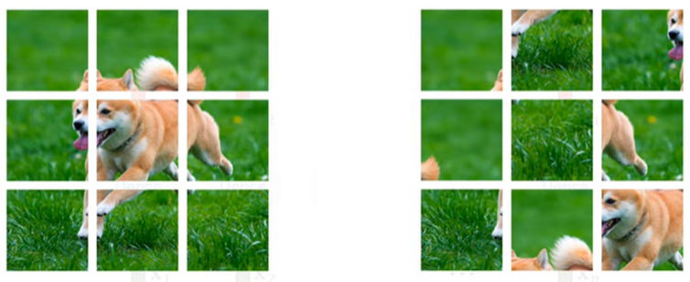
Vision Transformer (ViT)
Positional encoding is applied
Image from: https://www.youtube.com/watch?v=HZ4j_U3FC94&t=440s

Slide 5
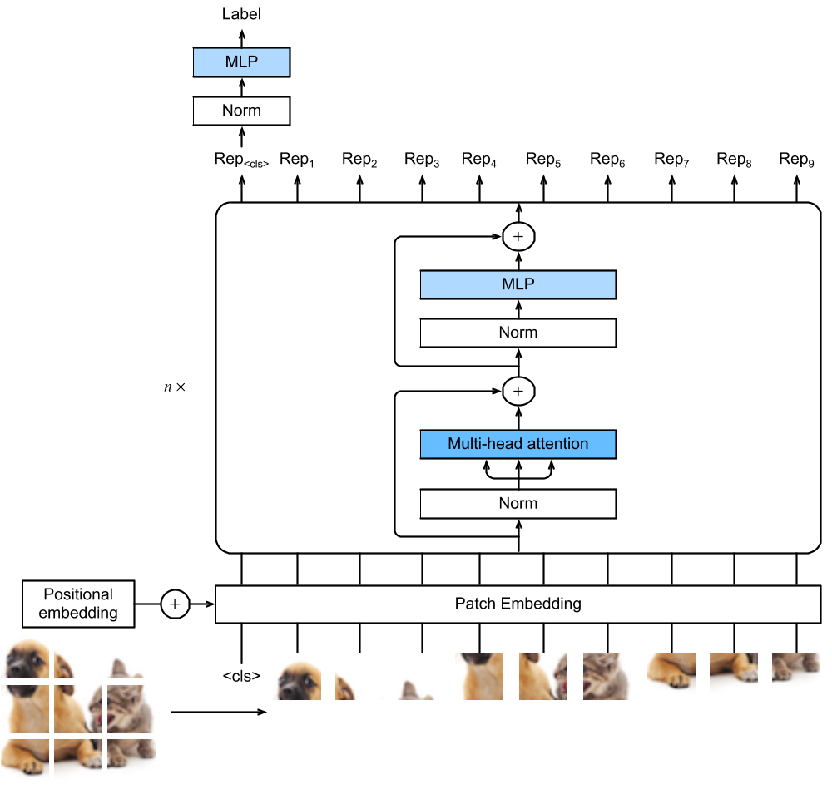
Notes:
The vision Transformer architecture. In this example, an image is split into 9 patches. A special “<cls>” token and the 9 flattened image patches are transformed via patch embedding and n Transformer encoder blocks into 10 representations, respectively. The “<cls>” representation is further transformed into the output label.

Slide 6
Vision Transformer (ViT)
“<cls>” token attends to all the image patches via self-attention.
Its representation from the Transformer encoder output is further transformed into the output label.
The MLP of ViT uses GELU as the activation function
  Gaussian Error Linear Unit
Uses pre-normalization
  Before multi-head attention or the MLP
  leads to more effective or efficient training

Slide 7
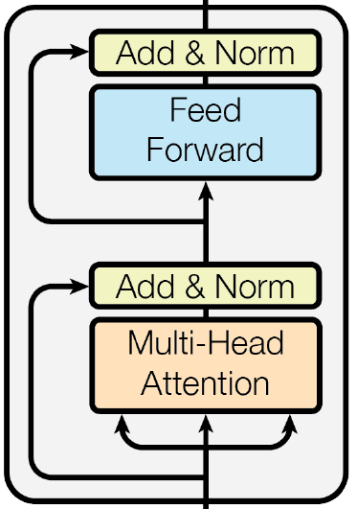
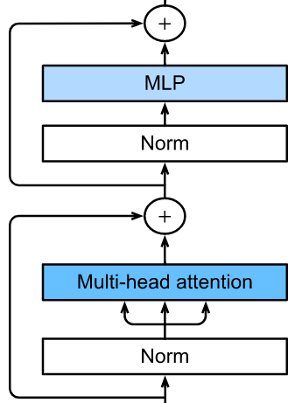
Pre-normalization
Pre-normalization
ViT (Dosovitskiyet al.)
Transformer (Vaswani et al.)

Slide 8


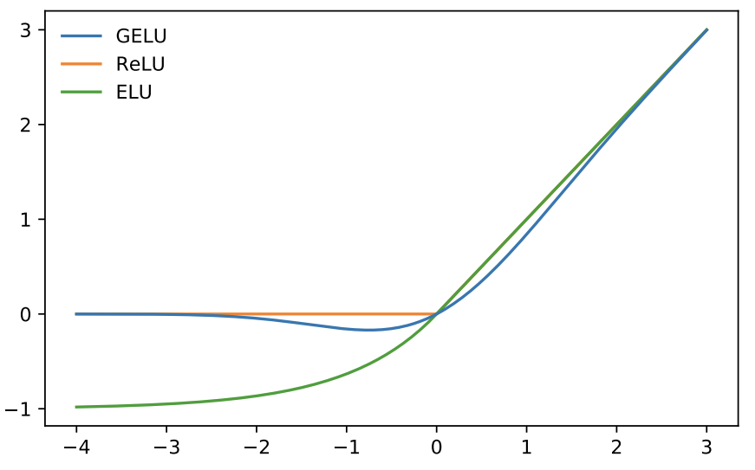
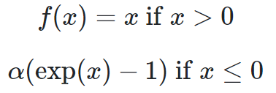
Gaussian Error Linear Units (GELU)
Cumulative distribution of N(0, 1)
Exponential linear unit (ELU)

Slide 9
Pre-training and Fine-tuning
Pre-trained on large dataset
Fine-tune to smaller dataset for downstream tasks
Does not outperform ResNet in small datasets.
  Lacks principles such as
    Translation invariance
    Locality
For large datasets, ViT
  Scales well
  Outperforms ResNets by a large margin

Slide 10
Fine-tuning
Pre-trained

Slide 11
ViT Reference
Vision Transformer for Image Classification
ViT Paper

Slide 12
Three modes of Transformer
Encoder-Decoder
Encoder-only
  BERT (Bidirectional Encoder Representations from Transformers)
Decoder-only
  GPT (Generative Pre-training)

Slide 13
BERT
Bidirectional Encoder Representations from Transformers
Improved the state of the art on
  Single text classification (e.g., sentiment analysis),
  Text pair classification (e.g., natural language inference)
  Question answering
  Text tagging (e.g., named entity recognition)

Slide 14
BERT
Faster compared to LSTM
Context of words is better learnt
Pre-training
  Masked language modeling (MLM)
  Next sentence prediction (NSP)

Slide 15
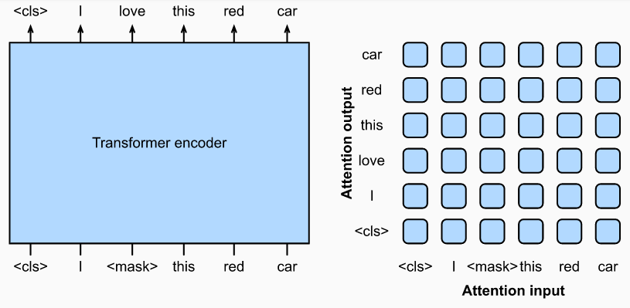
BERT
Left: Pretraining BERT with masked language modeling. Prediction of the masked “love” token depends on all input tokens before and after “love”. Right: Attention pattern in the Transformer encoder. Each token along the vertical axis attends to all input tokens along the horizontal axis.

Slide 16
Masked Language Modeling (MLM)
Input text with randomly masked token
  No need for manual labeling!
Predict the masked token
  Depends on input before and after it in the sequence
Encodes bidirectional context for representing words
Does not explicitly model the logical relationship between text pairs

Slide 17
Next sentence prediction (NSP)
Generating sentence pair for pre-training
  Half of the time they are indeed consecutive sentences with the label “True”
  Half of the time the second sentence is randomly sampled from the corpus with the label “False”.

Slide 18
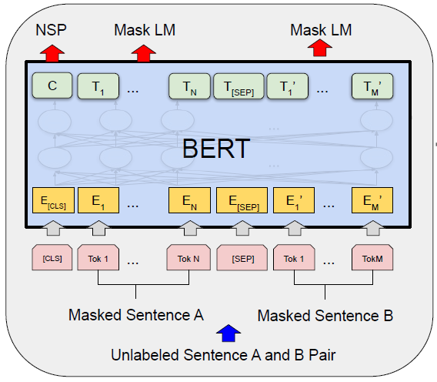
Pre-training MLM+NSP
Pre-training on MLM and NSP happens simultaneously

Slide 19
Loss calculation
Loss is linear combination of Loss_{MLM} and Loss_{NSP}
Loss_{NSP}
  Binary cross-entropy loss.
Loss_{MLM}
  Each output token is passed through a FC layer to make a distribution over the words in the vocabulary
  Only the masked tokens contribute to loss.
  Cross-entropy loss is used

Slide 20
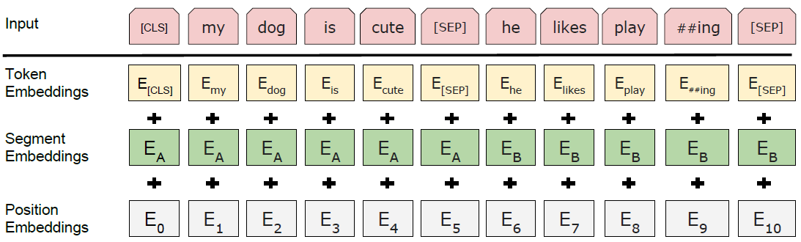
Embedding
The BERT input sequence unambiguously represents both single text and text pairs.
[CLS] is a special symbol added in front of every input example
[SEP] is a special separator token (e.g. separating questions/answers).
To distinguish text pairs, the learned segment embeddings e_{A} and e_{B} are added to the token embeddings of the first sequence and the second sequence, respectively. For single text inputs, only e_{A} is used.
Notes:
The input embeddings are the sum of the token embeddings, the segmentation embeddings and the position embeddings.

Slide 21
BERT
The same pre-trained model parameters are used to initialize models for different down-stream tasks.
Fine-tuning
  All parameters are fine-tuned.
  The additional output layer is trained from scratch
For Fine-tuning in Q&A task
  Input: Question + passage containing the answer
  Output: start + end word encapsulating the answer

Slide 22
Parameters
BERT Base
  110 million parameters
BERT Large
  340 million parameters

Slide 23
BERT Reference
BERT Neural Network - EXPLAINED!
BERT Paper

Slide 24
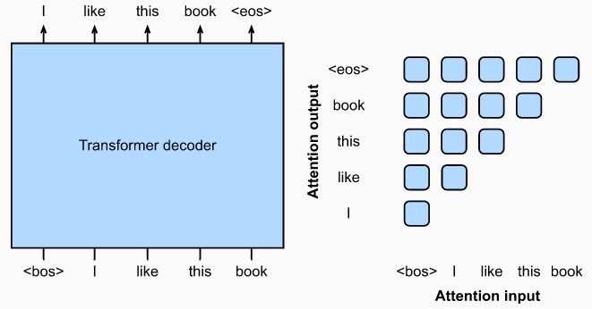
GPT (Generative Pre-training)
Decoder-only Transformer
Notes:
Left: Pre-training GPT with language modeling. The target sequence is the input sequence shifted by one token. Both “<bos>” and “<eos>” are special tokens marking the beginning and end of sequences, respectively.
Right: Attention pattern in the Transformer decoder. Each token along the vertical axis attends to only its past tokens along the horizontal axis (causal).

Slide 25
GPT (Generative Pre-training)
100 million parameters
Needs to be fine-tuned for downstream tasks
GPT-2
  Uses pre-normalization
  Improved initialization
  Improved weight-scaling
  Pre-trained on 40 GB of text
  1.5 billion parameters

Slide 26
GPT-3
In-context learning
  No model update (no fine-tuning)
  Input sequence with task description
  Task-specific input output examples
  A prompt (Task input)
Category | Task-specific input output examples
Zero-shot | None
One-shot | One
Few-shot | A few

Slide 27
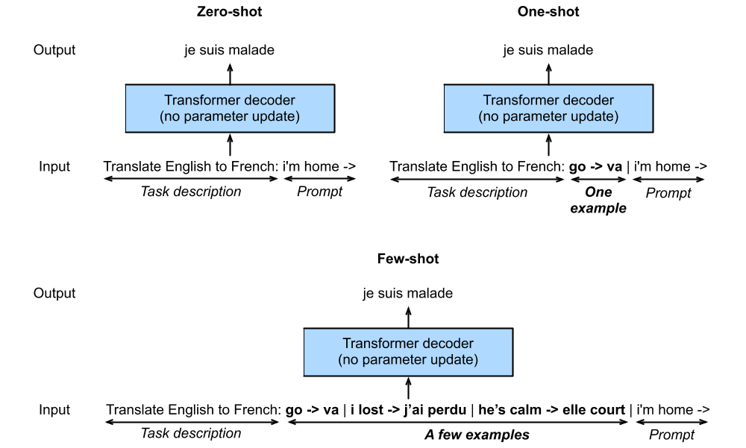
In-context Learning

Slide 28
GPT-3
Same Transformer Decoder architecture as in GPT-2
Pre-trained with 300 billion tokens

Slide 29
ChatGPT
GPT 3.5
  Language model
  Transformer architecture
Reinforcement Learning
  from Human Feedback (RLHF)

Slide 30
ChatGPT
Initial model trained using supervised fine-tuning
  Human AI trainers provided conversations, playing both sides
    The user
    An AI Assistant.
  Trainers had access to model-written suggestions to help them compose their responses.

Slide 31
Reward Model
We need two or more model responses, ranked by quality
Examine conversations between AI trainers and chatbot
  Randomly select a model-written message
  Sample several alternative completions
  Rank them
Using these reward models fine-tuning is done using Proximal Policy Optimization.

Slide 32
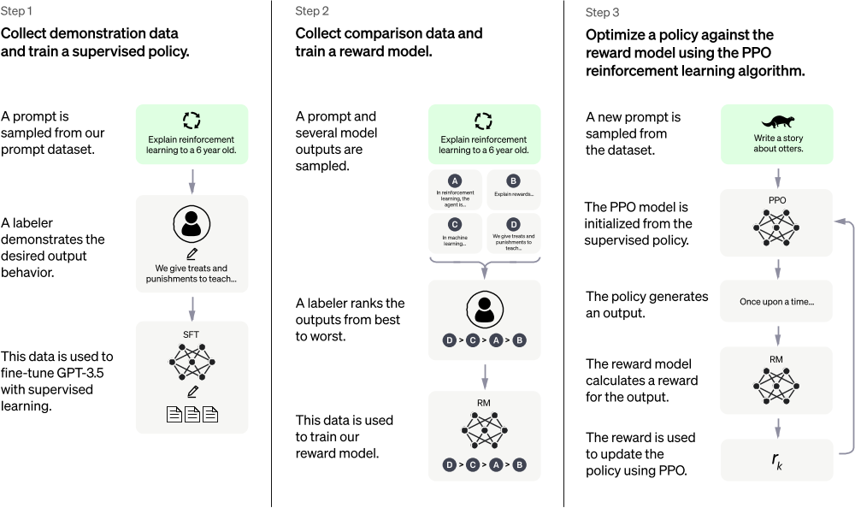
ChatGPT Training workflow
Notes:
SFT – Supervised fine-tuning
PPO – Proximal Policy Optimization

Slide 33
Limitations
Plausible-sounding but incorrect or nonsensical answers
Sensitive to tweaks to the input phrasing
Excessively verbose
Overuses certain phrases
Sometimes responds to harmful instructions or exhibit biased behavior

